Slide 1

EEC 687 | Mobile Computing
MazedOut
Google Cardboard & Virtual Reality
Final Report
Supervisor
Dr. Chansu Yu
Presented By
Arpit Patel
Jaimal Bhairavia

Slide 2

Outline
Development Phases
MazedOut 3.0 - GamePlay
Features Implemented
Scripts implemented
Issues Encountered
Conclusion

Slide 3
Development Phases
Initial Stage
First Maze
Expanded Maze & Canvas
Final Maze

Slide 4
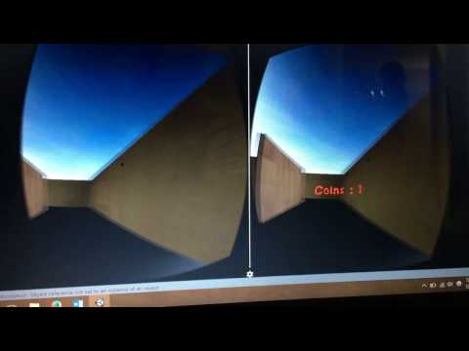
MazedOut Gameplay

Slide 5
Features Implemented
Coins change color on first click
Coins collected and score updated on second click
Final score displayed on the scoreboard
Game restarts when restart option selected

Slide 6
Features Implemented
Gameplay Instructions on the main menu
3 scenes interfaced to create main menu and scoreboard
Auto Walk of the player
Stopping by looking at the ground

Slide 7
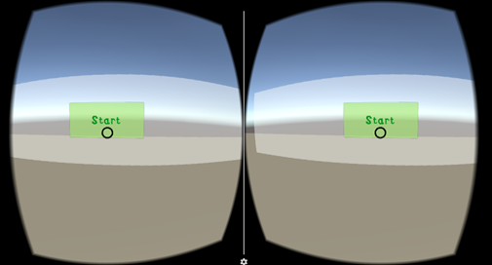
Script Implementation - Start.cs
SceneManager.LoadScene("Final Maze");

Slide 8
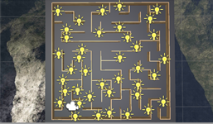
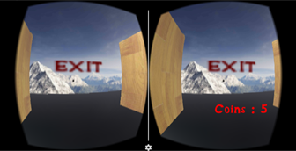
Script Implementation - Control.cs
Start() & Update()
hit.collider.name.Contains("coin") --
SceneManager.LoadScene("Scoreboardscene");
updatecoin () & updatescore()
Notes:
Start() & Update() -- refer to page in report

Slide 9
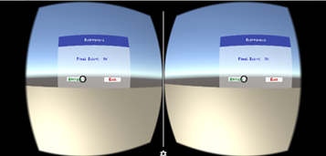
Script Implementation - Scoreboard.cs
PlayerPrefs.GetInt ("Final Score") -- Showing Score
Reset and quit function

Slide 10
Issues Encountered
Looking through walls - making game objects opaque
Auto-stop feature
Exportation problem
Ending the Game
Making Start menu & Scoreboard menu
Scoreboard value

Slide 11
Future Work

Slide 12
Conclusion

Slide 13
Thank you !
Questions ?

